Slide 1
Maths
Unit 1.1 – Place Value
20.08.2026
WALT: Use knowledge of place value to multiply and divide whole numbers by 10, 100 and 1,000.

Slide 2
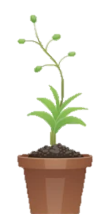
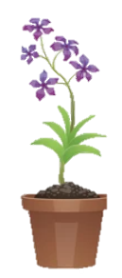
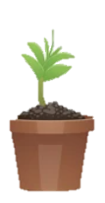
WALT: Use knowledge of place value to multiply and divide whole numbers by 10, 100 and 1,000.
With support, I can multiply and divide decimal and whole numbers by 10, 100 and 1,000.
Independently, I can multiply and divide decimal and whole numbers by 10, 100 and 1,000.
I can write my own question when given the answer.

Slide 3
Homework
Complete pages 9 – 13 in your Workbooks.
Due – Tuesday 25th August 2026.

Slide 4
Retrieval Practice –
WALT: Use knowledge of place value to multiply and divide whole numbers by 10, 100 and 1,000.
Last Lesson What is the value of the underlined number? 33,234.539 | Last Lesson Mr. Jon thinks of a number. It is greater than 45. Has an even number in the tenths and hundredths. Rounds to 60 when rounding to the nearest 10. What could his number be?
Last Year Here is a sequence: 1, 5, 9, 13, 17 The rule is ‘add 4’. Write the next 3 terms. | Last Year Write the number is words and digits. 40,000 + 5,000 + 80 + 0.2
9 thousandths
0.009
Forty-five thousand and eighty, point two.
45,080.2
21, 25, 29

Slide 5
Starter – Match the equivalent calculations.
WALT: Use knowledge of place value to multiply and divide whole numbers by 10, 100 and 1,000.
X 100
X 100 ÷ 1,000
X 100 ÷ 10
÷ 10
X 1,000 ÷ 100
X 10 X 10

Slide 6
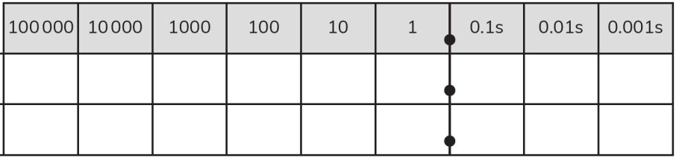
How do we multiply by 10?
WALT: Use knowledge of place value to multiply and divide whole numbers by 10, 100 and 1,000.
We move every digit one place to the left.
54.2 x 10 =

Slide 7
How do we multiply by 100?
WALT: Use knowledge of place value to multiply and divide whole numbers by 10, 100 and 1,000.
We move every digit two places to the left.
54.2 x 100 =

Slide 8
How do we multiply by 1,000?
WALT: Use knowledge of place value to multiply and divide whole numbers by 10, 100 and 1,000.
We move every digit three places to the left.
54.2 x 1,000 =

Slide 9
Check your understanding
WALT: Use knowledge of place value to multiply and divide whole numbers by 10, 100 and 1,000.
On your place value grids complete these calculations.
36 x 100 =
0.43 x 10 =
5.921 x 1,000 =
22.32 x 1,000 x 10 =
3,600
4.3
5,921
223,200

Slide 10
How do we divide by 10?
WALT: Use knowledge of place value to multiply and divide whole numbers by 10, 100 and 1,000.
We move every digit one place to the right.
46,321 ÷ 10 =

Slide 11
How do we divide by 100?
WALT: Use knowledge of place value to multiply and divide whole numbers by 10, 100 and 1,000.
We move every digit two places to the right.
46,321 ÷ 100 =

Slide 12
How do we divide by 1,000?
WALT: Use knowledge of place value to multiply and divide whole numbers by 10, 100 and 1,000.
We move every digit three places to the right.
46,321 ÷ 1,000 =

Slide 13
Check your understanding
WALT: Use knowledge of place value to multiply and divide whole numbers by 10, 100 and 1,000.
On your place value grids complete these calculations.
56,221.3 ÷ 100 =
56 ÷ 10 =
1,092 ÷ 1,000 =
2,345 ÷ 1,000 X 100 =
562.213
5.6
1.092
234.5

Slide 14
WALT: Use knowledge of place value to multiply and divide whole numbers by 10, 100 and 1,000.
Work with me.
Work independently.
Look at these number cards. Write the correct letter of the card next to the correct sentence.
Find the missing numbers.
56.602 x 1,000 =
789 ÷ 100 =
0.078 x 10 =
0.95 ÷ 100 =
8.345 X 100 ÷ 1,000 =
A
B
C
D
6.1
61
610
0.61
One hundredth of 61
One thousand times bigger than 0.061
The number one hundred times smaller than 610.
d) Write your own sentence for the card that is left.

Slide 15
WALT: Use knowledge of place value to multiply and divide whole numbers by 10, 100 and 1,000.
Work with me.
Work independently.
Find the missing numbers.
56.602 x 1,000 =
789 ÷ 100 =
0.078 X 10 =
0.95 ÷ 100 =
8.345 X 100 ÷ 1,000 =
56,602
7.89
0.78
0.0095
0.8345

Slide 16
WALT: Use knowledge of place value to multiply and divide whole numbers by 10, 100 and 1,000.
Look at these number cards. Write the correct letter of the card next to the correct sentence.
A
B
C
D
6.1
61
610
0.61
D
One hundredth of 61
One thousand times bigger than 0.061
The number one hundred times smaller than 610.
d) Write your own sentence for the card that is left.
B
A

Slide 17
WALT: Use knowledge of place value to multiply and divide whole numbers by 10, 100 and 1,000.
With support, I can multiply and divide decimal and whole numbers by 10, 100 and 1,000.
Independently, I can multiply and divide decimal and whole numbers by 10, 100 and 1,000.
I can write my own question when given the answer.

Slide 18
Plenary – There are ten buses in the carpark. Each bus has ten people on it. Each person has ten fingers. One bus drives away. One person gets off one of the remaining buses and leaves the carpark. How many fingers are left in the car park?
WALT: Use knowledge of place value to multiply and divide whole numbers by 10, 100 and 1,000.
890 fingers

